Slide 1
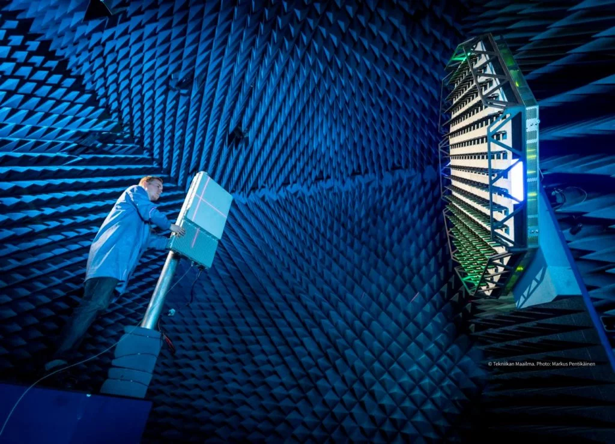
ABLE Adaptive Ultrasound DNN Aided
Beamformer
Ben Luijten, Regev Cohen, Frederik J. de Bruijn, Harold A.W. Schmeitz, Massimo Mischi, Yonina C. Eldar, Ruud J.G. van Sloun
DECEMBER 2020
Amit Moses
Dor Haim Shmuel
Supervisor:
Dr. NiR Shlezinger
19/06/22

Slide 2
Outline
ULTRASOUND
Medical Uses
Techniques
preprocess
Beamforming
Beamforming Principals
DAS
Adaptive Beamformer – MVDR & EBMV
MV complexity
DNN Augmented Adaptive Beamformer
DNN – Aided hybrid inference
ABLE
Results and conclusions
Model implementation
Notes:
In order to Fully Understand What Stands Behind The problem of Spatial Parameters Estimation,
We will start From the beginning By formulating The Basic Form Of Array and Measurements.
Then we will go through model Based Estimation Methods which are popular today.
We will display the challenges and the weakest links in those algorithm and Their origin (From where the are Following)
We will present Solutions That come from the Field on Data Drive Algorithms that uses the model-based structure,
And then I will present the motivation for developing New Model For the DOA Estimation problem.
Lets Start

Slide 3
Ultrasound

Slide 4
Ultrasound
Diagnostic purposes without the use of ionizing radiation.
Benefits:
In-expensive
Relatively portable
Very little discomfort for the patient.
fetal scans during pregnancy
Notes:
In this lecture we will talk about Ultrasound Beamforming, So for start, we need to understand what is Ultrasound.
For decades, ultrasound imaging has been used for diagnostic purposes
The interior structures of the human body can be displayed in real-time and without the use of ionizing radiation.
Ultrasound imaging benefit from being in-expensive, relatively portable, and it provides very little discomfort for the patient.
Ultrasound examinations are most known from fetal scans during
pregnancy.

Slide 5
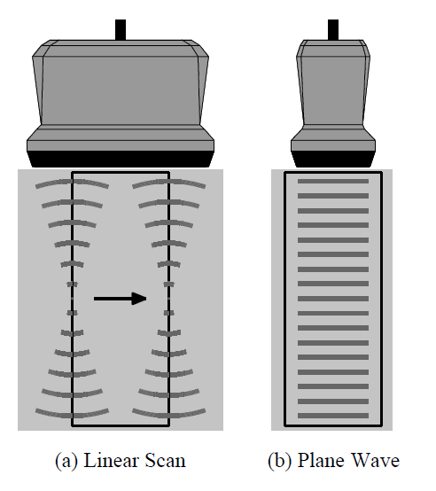
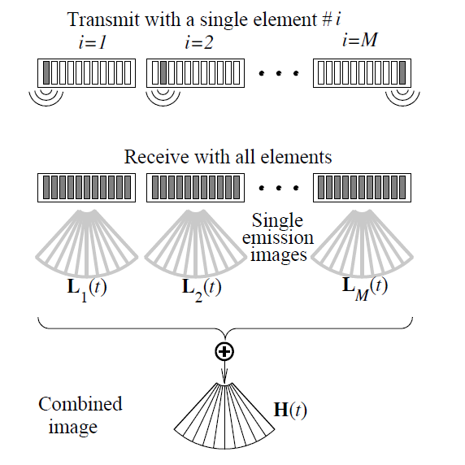
Ultrasound
Ultrasound scan
Emitting high-frequency acoustic wave fields into the body of the patient
Waves are reflected at different depth due to changes in the tissue characteristics
The reflected echoes are measured by an array of piezo-electric sensors.
Linear Scan & Plane Wave
Synthetic Aperture
Notes:
Ultrasound scan carrying out by
Emitting high-frequency acoustic wave fields into the body of the patient – MHz range and thus, out of the human audible range (Linear array scan , PW, SA)
Due to changes in the tissue characteristics, the acoustic waves are reflected at different depth within the human body.
The reflected echoes are measured by an array of piezo-electric sensors.

Slide 6
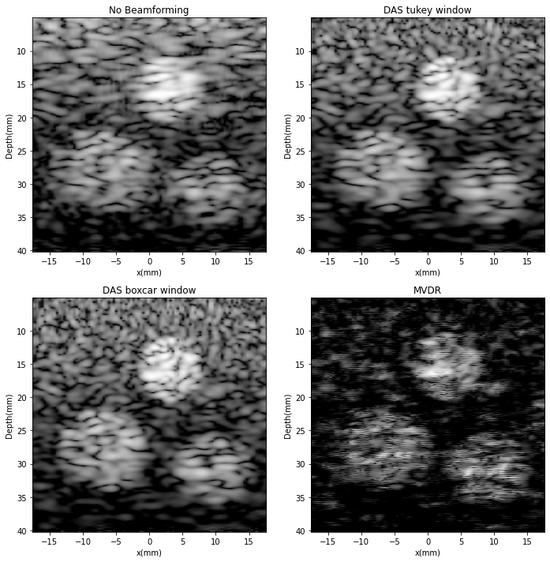
Ultrasound
Combining these sensor signals using array processing techniques, the distances and intensities of the echoes form the ultrasound B-mode image.
Notes:
Here we can see two different image reconstruction from different processing methods

Slide 7
Ultrasound - Preprocess
Time-gain compensation - The attenuation coefficient of tissue
Anti-aliasing filter (low-pass) and then A/D conversion. The input data is already digitized here, so no need for anti-alias filtering.
High-pass filter - Summing process in beamforming can produce very high values if low frequencies are included. This can result in the generation of a dynamic range in the data that exceeds what's allowable by the number of bits, yielding data loss.
Interpolation is used to up-sample the signal in order to achieve more accurately delays in the beamforming process
Time-Gain compensation
anti-aliasing filter + A/D conversion
High-pass filter
Up-sample
Beamformer
Image reconstruction
Notes:
In order to extract a good quality image from the received ultrasound signal we must pre-process it

Slide 8
Beamforming

Slide 9
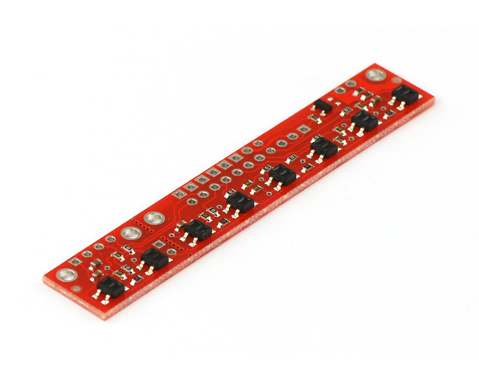
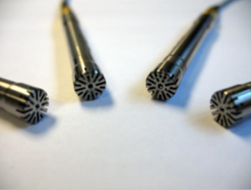
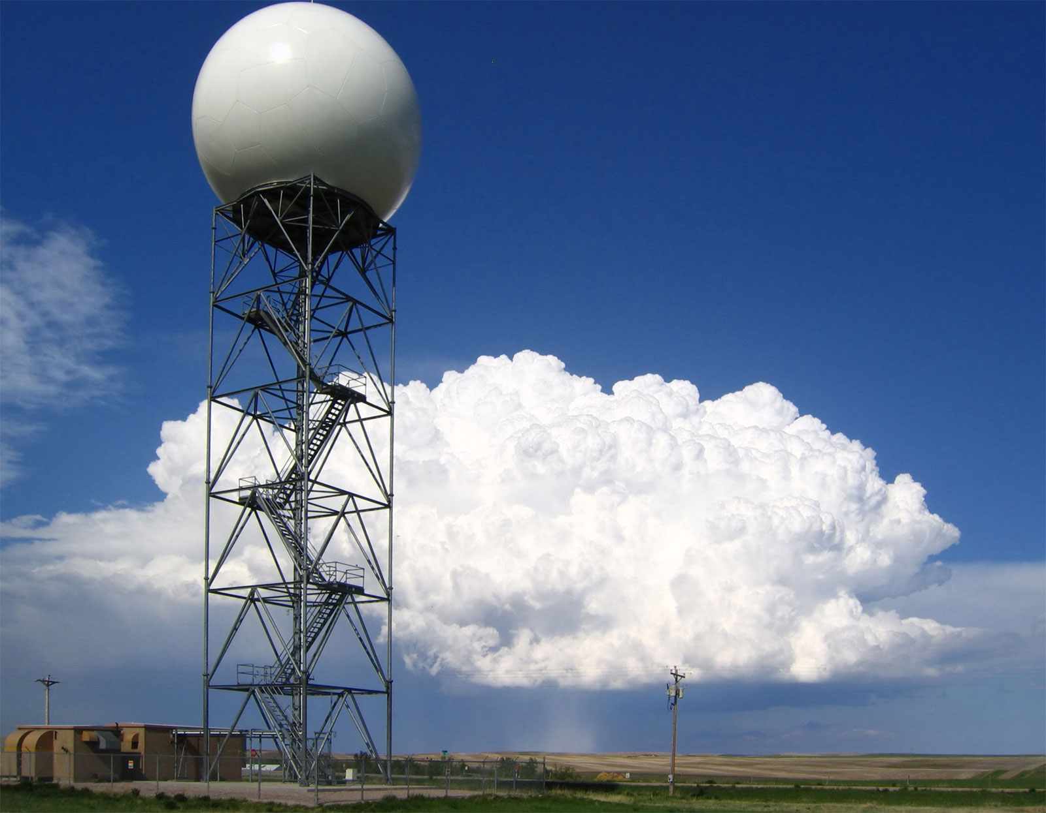
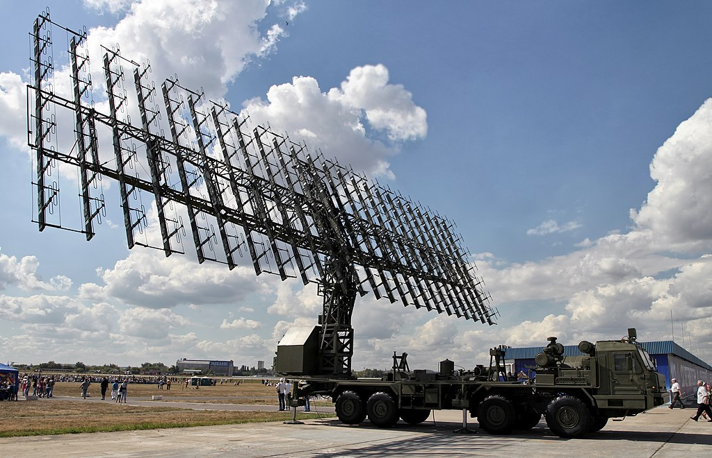
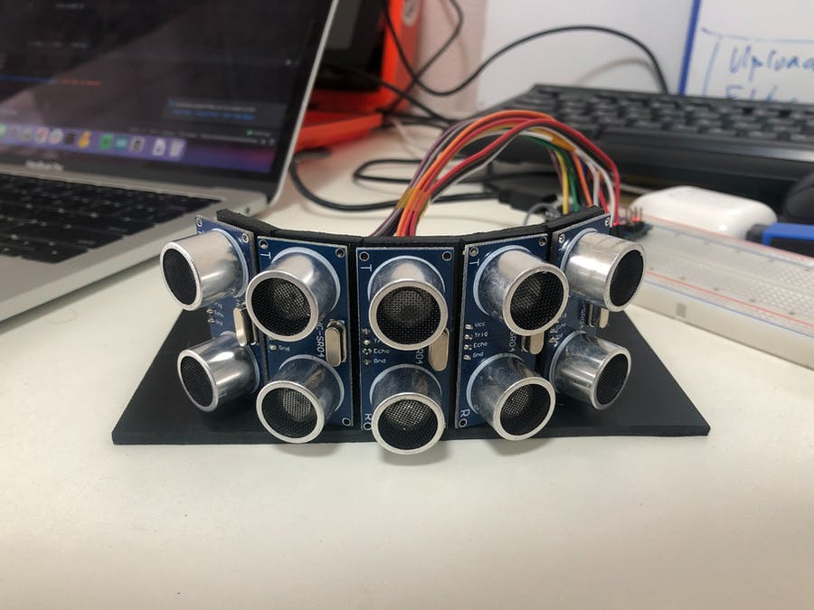
array Processing
Estimation of Source parameters Based on information acquired by Array of Sensors
Weather Radars
IR
Sensors
Mic Array
Military Radar
Ultra-Sonic Sensors
Notes:
Using An array Of Sensors, Our Goal is to estimate the Source parameters – like Direction, Range, the Transmitted Data, The Reciver Response And so on,
by using available spatial information.
This Information is Acqiuerd by sampling emitted Waves with a set of Sensors.
The Array of Sensors Can be:
IR Sensors for Detection of Heat or Infrared Radiation Signals
Microphone Sensors For Audio Signals
Weather or Military Radars Which uses Antennas in Arbitrary Shapes
OR Even Some Ultra-Sonic Sensors like Dolphines uses Which intended For Sound, Sonar and etc.

Slide 10
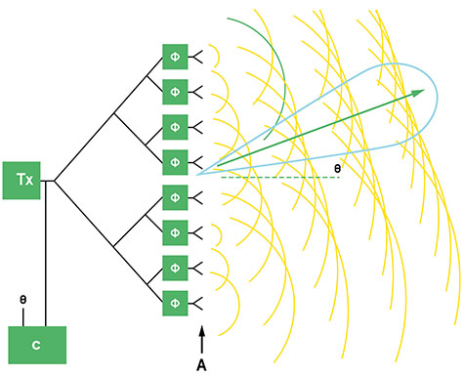
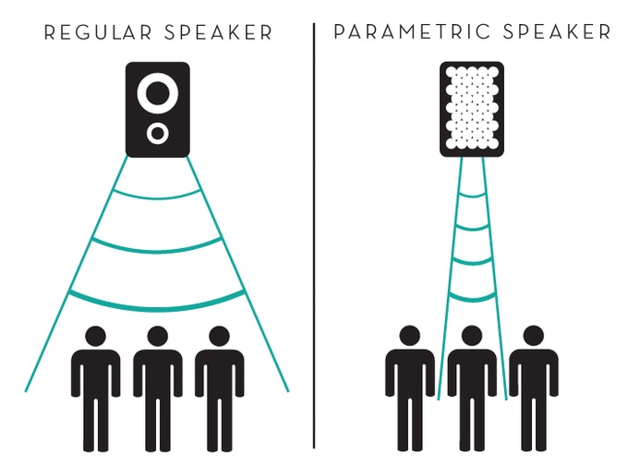
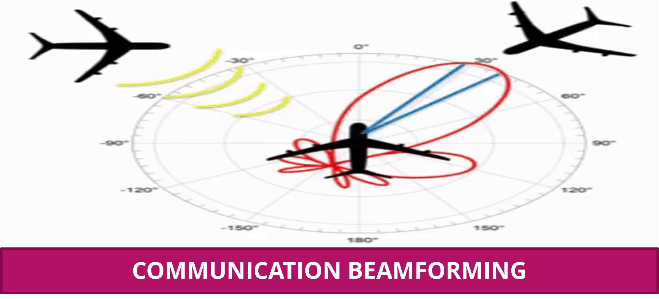
Beamforming Principals
Technique for directional signal focusing.
signals at specific directions experience constructive and destructive interference.
Voice and Speech Beamforming
Phased Array (Beamforming)

Slide 11
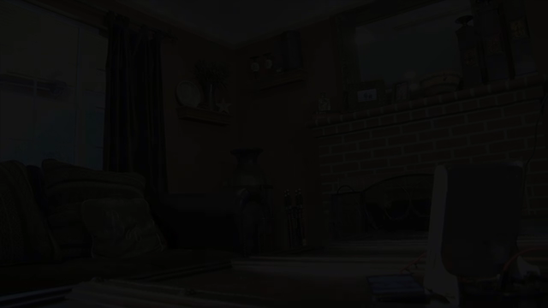

Beamforming Principals
Taken from Soundlazer "Snap"

Slide 12
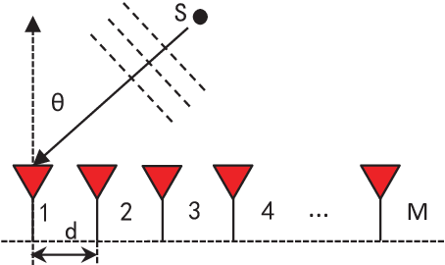
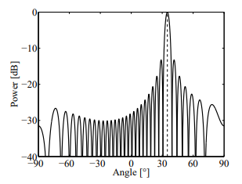
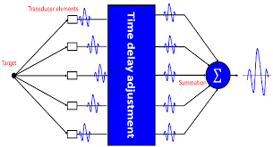
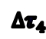
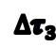
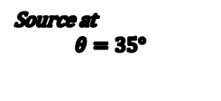

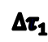


Beamforming Principals
Weighting the incoming signals to yield maximum output power at relevant direction
$$∆τ_{1}$$
Source at
$$θ=35°$$
Source at
$$θ=35°$$
w1
$$∆τ_{2}$$
w2
$$∆τ_{3}$$
w3
$$∆τ_{4}$$
w4
Amplified steered Signal
$$∆τ_{5}$$
w4
Notes:
To understand the principals behind Array processing we will analyze the simple case

Slide 13
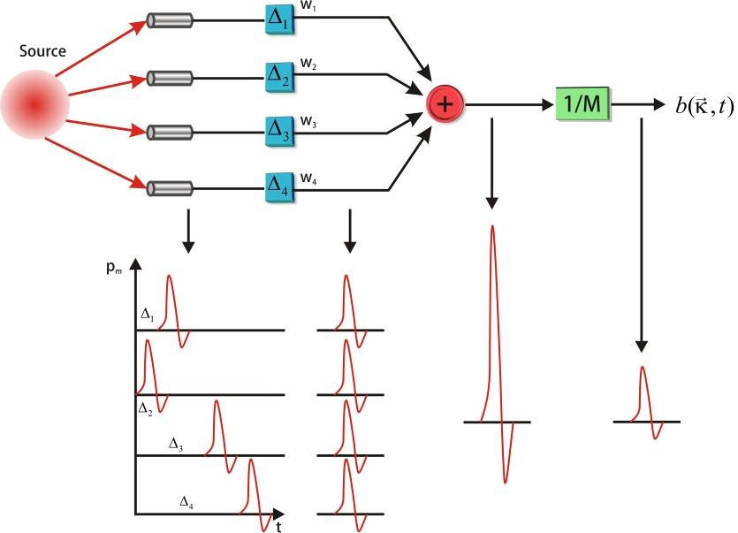
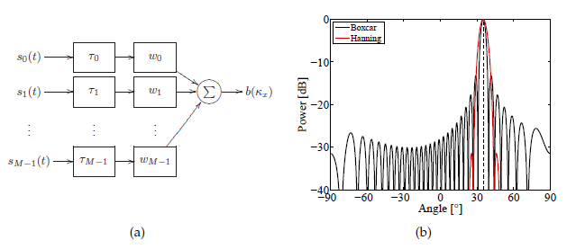
Beamforming Methods
DAS – Delay & Sum
Maximize power output by delaying, weighting, and summing the sensor signals.
Predefined apodization weights, data independent.
main-lobe width
side-lobe level
Notes:
1. Uses predefined apodization weights, which are independent of the input data.
2. Compromise between the main-lobe width and the side-lobe level exists

Slide 14
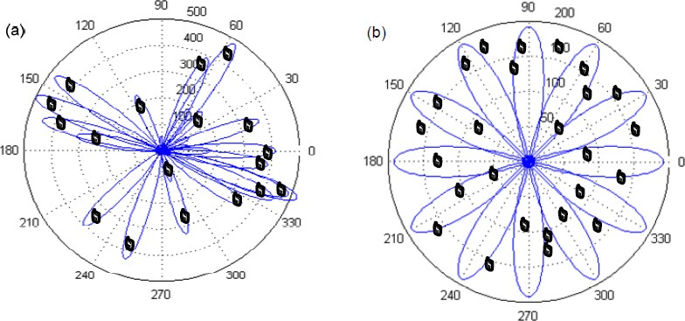
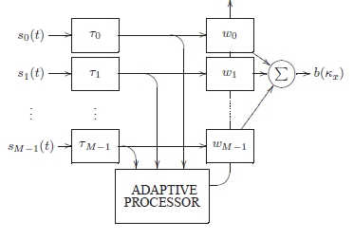
Adaptive Beamforming
Automatically generate weights which are data dependent
optimized directly from the measured wave field
Time-variant Targets
Notes:
As I said, the das beamformer is data independent.
The Adaptive beamformers are automatically generate weights which are data dependent. optimized directly from the measured wave field

Slide 15
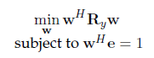
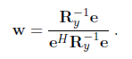
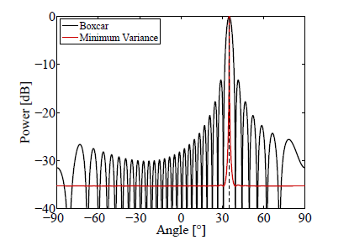
Adaptive Beamforming - MVDR
Minimize the contributions from noise and interfering signals (Minimum Variance)
Closed-form solution (Model – based)
Optimization Problem
Requires Inversion of covariance matrix
Notes:
The MVDR is adaptive beamformer which Minimize the contributions from noise and interfering signals
The Optimization problem aims to minimize the noise of the receiving signal, where Ry is the covariance matric of the receiving signal and e is a steering vector.
Here we have closed-form solution, that is not an iterative optimization problem.

Slide 16
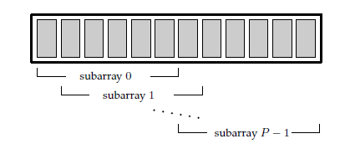
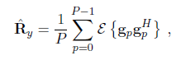
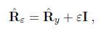
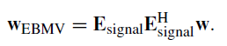
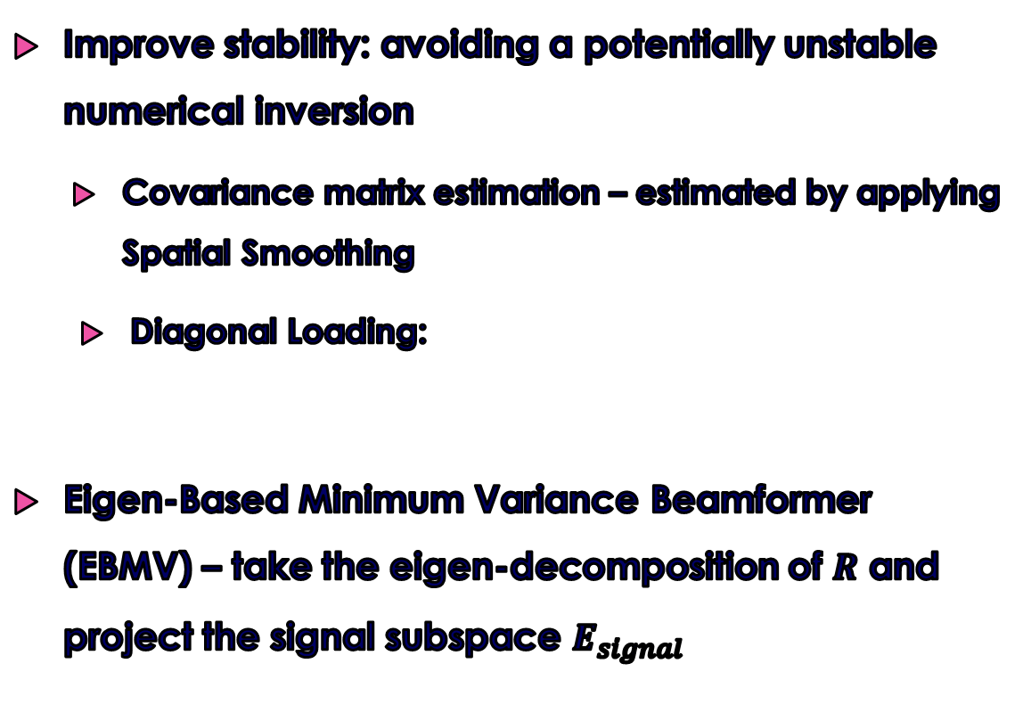
Adaptive Beamforming – MVDR improvement
Improve stability: avoiding a potentially unstable numerical inversion
Covariance matrix estimation – estimated by applying Spatial Smoothing
Diagonal Loading:
Eigen-Based Minimum Variance Beamformer (EBMV) – take the eigen-decomposition of $R$ and project the signal subspace $E_{signal}$

Slide 17
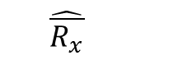
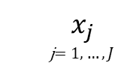

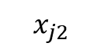
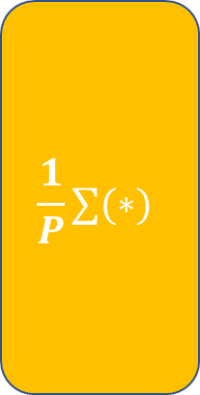


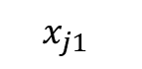
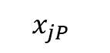
MVDR improvements
Spatial Smoothing
Avoiding potentially unstable numerical inversion, by increasing the matrix rank
Spatial Smoothing
Divide into P subarray
$$x_{j1}$$
$$\hat{R_{x1}}$$
Empirical Cov
$$\frac{1}{P}∑(∗)$$
$$x_{j2}$$
$$\hat{R_{x2}}$$
$$x_{j}$$ j$=1,…,J$
Empirical Cov
$$\hat{\overline{R_{x}}}$$
$$x_{jP}$$
$$\hat{R_{xP}}$$
Empirical Cov

Slide 18
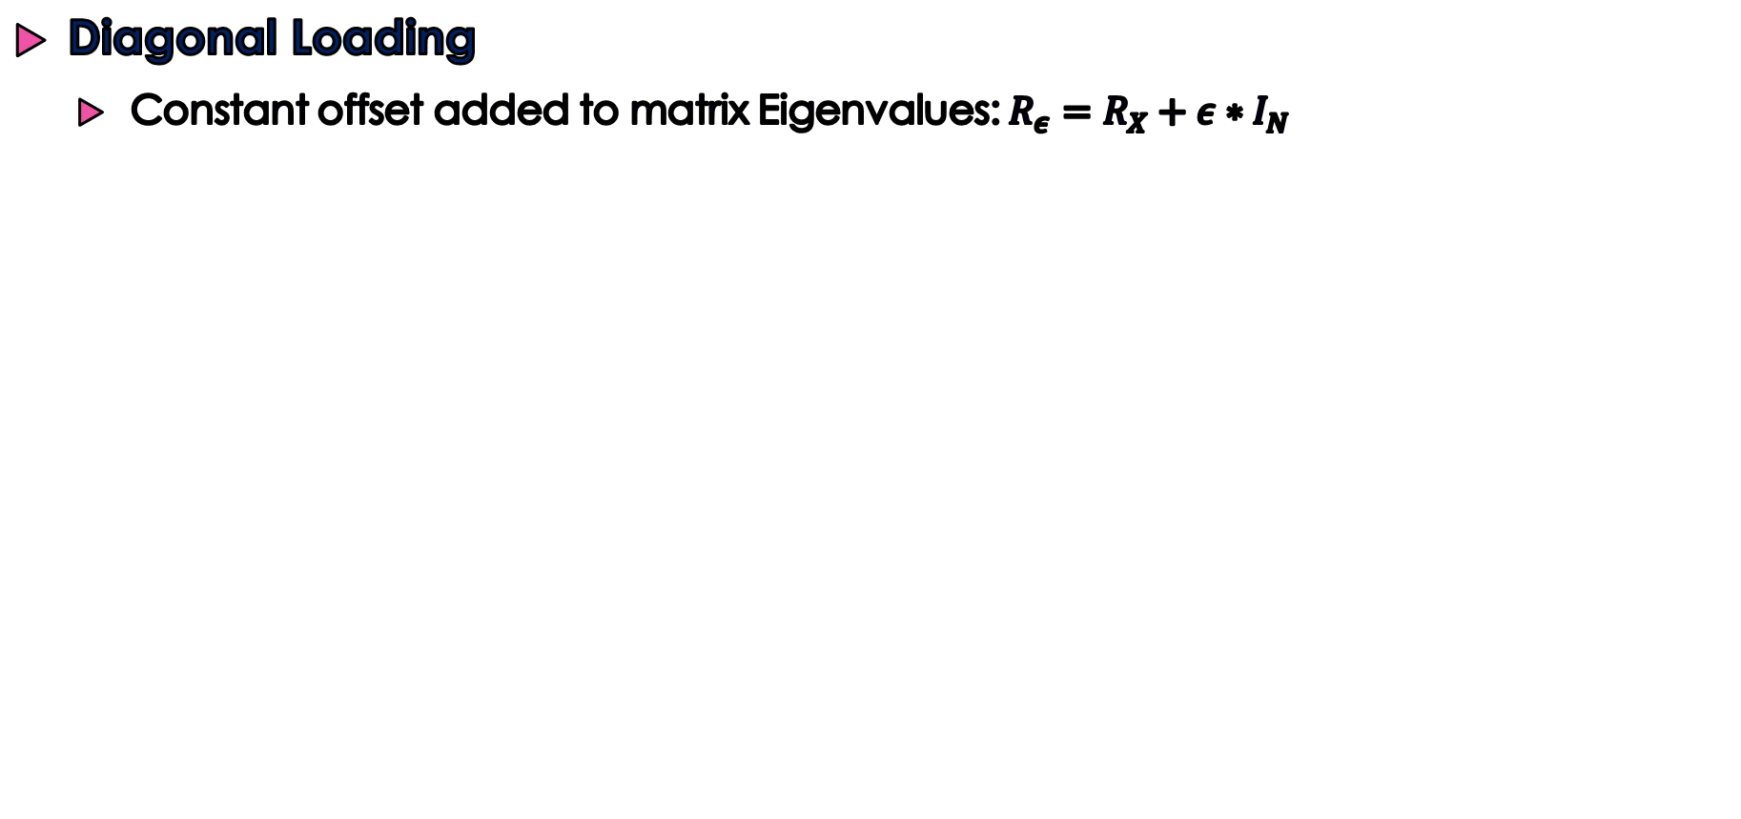
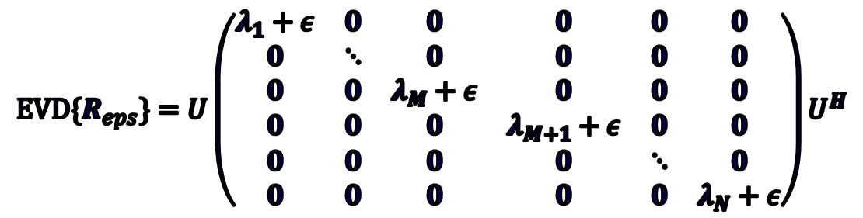
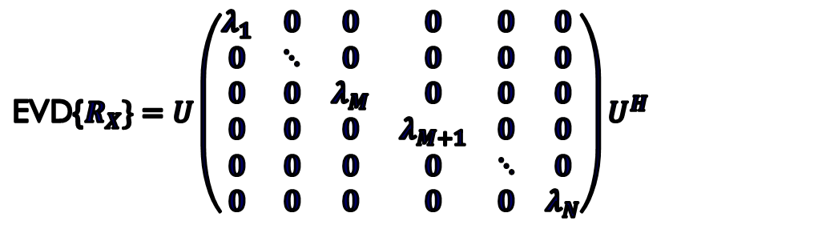
MVDR improvements
Diagonal Loading
Constant offset added to matrix Eigenvalues: $R_{ε}=R_{X}+ε∗I_{N}$
EVD{$R_{X}\}=U\left(\begin{matrix}λ_{1} & 0 & 0 & 0 & 0 & 0 \\ 0 & ⋱ & 0 & 0 & 0 & 0 \\ 0 & 0 & λ_{M} & 0 & 0 & 0 \\ 0 & 0 & 0 & λ_{M+1} & 0 & 0 \\ 0 & 0 & 0 & 0 & ⋱ & 0 \\ 0 & 0 & 0 & 0 & 0 & λ_{N}\end{matrix}\right)U^{H}$
$${EVD\{R}_{eps}\}=U\left(\begin{matrix}λ_{1}+ε & 0 & 0 & 0 & 0 & 0 \\ 0 & ⋱ & 0 & 0 & 0 & 0 \\ 0 & 0 & λ_{M}+ε & 0 & 0 & 0 \\ 0 & 0 & 0 & λ_{M+1}+ε & 0 & 0 \\ 0 & 0 & 0 & 0 & ⋱ & 0 \\ 0 & 0 & 0 & 0 & 0 & λ_{N}+ε\end{matrix}\right)U^{H}$$

Slide 19
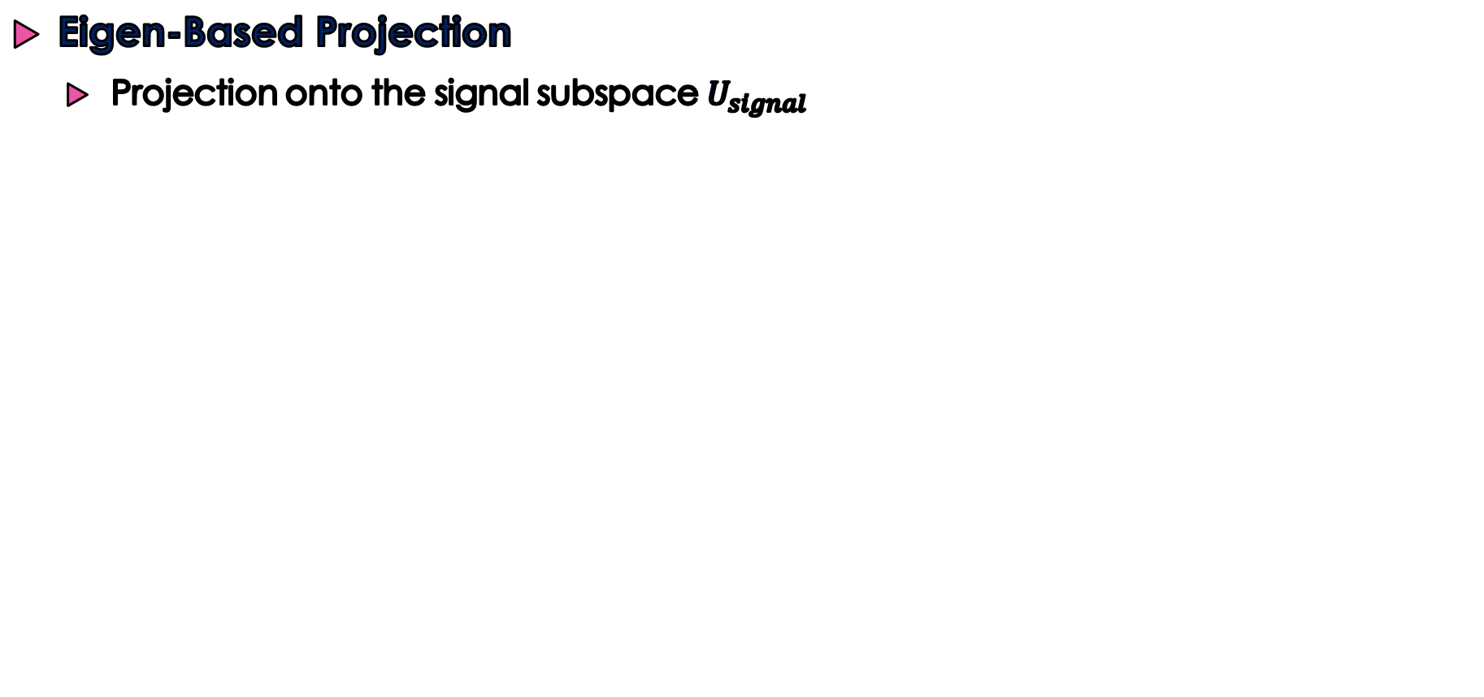



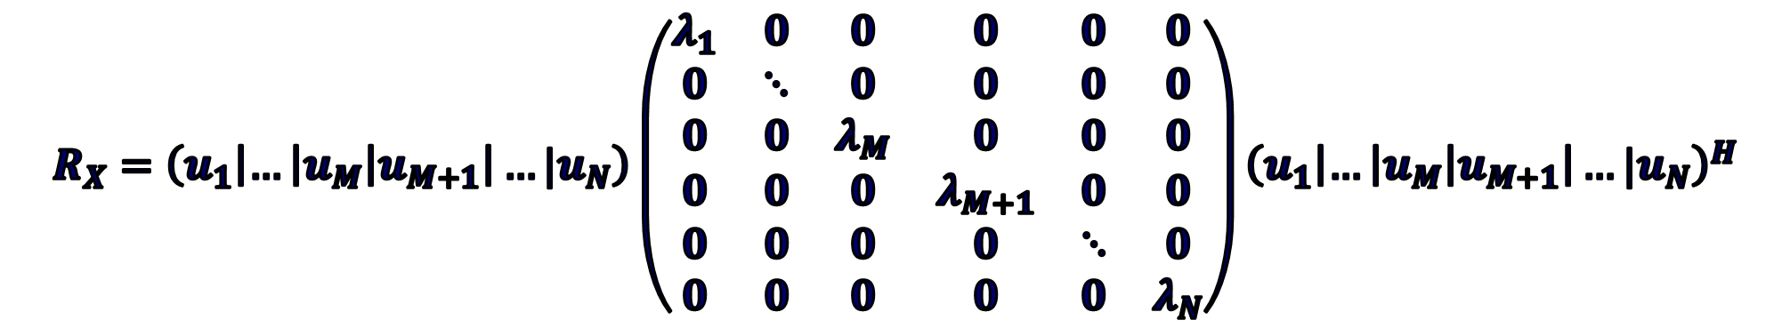
MVDR improvements
Eigen-Based Projection
Projection onto the signal subspace $U_{signal}$
Largest M Eigenvalues
$$R_{X}=\left(u_{1}\left|…\right|u_{M}\left|u_{M+1}\right|…|u_{N}\right)\left(\begin{matrix}λ_{1} & 0 & 0 & 0 & 0 & 0 \\ 0 & ⋱ & 0 & 0 & 0 & 0 \\ 0 & 0 & λ_{M} & 0 & 0 & 0 \\ 0 & 0 & 0 & λ_{M+1} & 0 & 0 \\ 0 & 0 & 0 & 0 & ⋱ & 0 \\ 0 & 0 & 0 & 0 & 0 & λ_{N}\end{matrix}\right){\left(u_{1}\left|…\right|u_{M}\left|u_{M+1}\right|…|u_{N}\right)}^{H}$$
Signal Subspace $U_{S}$
Noise Subspace $U_{N}$
Smallest N-M Eigenvalues
$$\left\{λ_{M+1}, …,λ_{N}\right\}≈σ^{2}$$

Slide 20
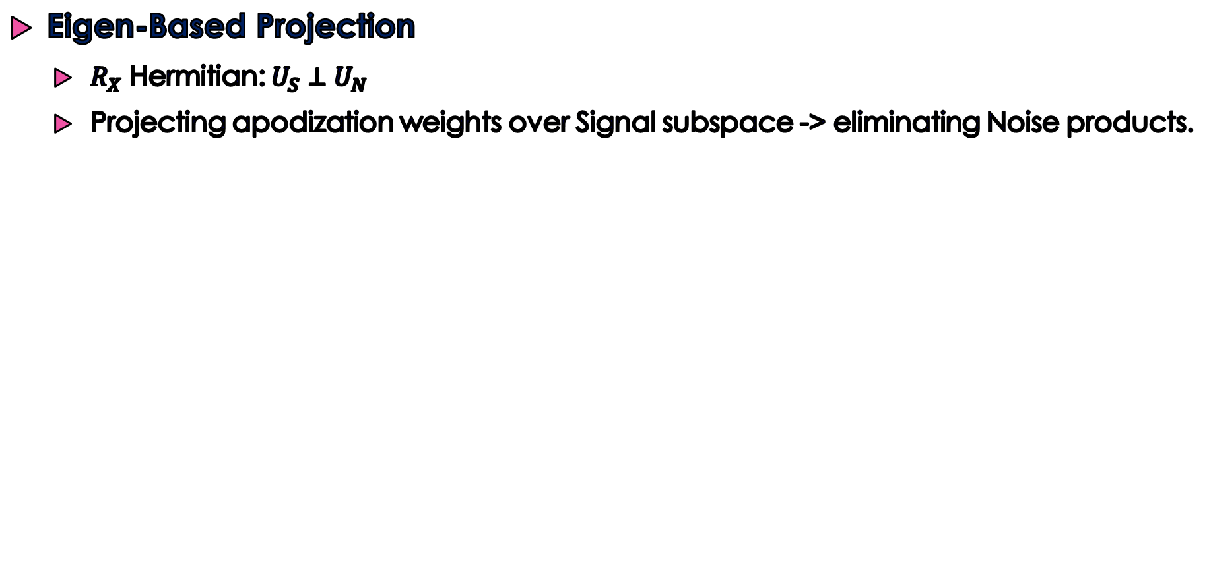


MVDR improvements
Eigen-Based Projection
$R_{X}$ Hermitian: $U_{S}⊥U_{N}$
Projecting apodization weights over Signal subspace -> eliminating Noise products.
$$W_{EBMV}=U_{S}U_{S}^{H}W_{MV}$$
$${{W_{EBMV}∗U}_{N}}_{i}=0 , ∀i∈\{M+1,…,N\}$$

Slide 21
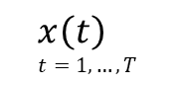
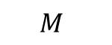
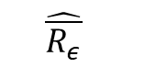



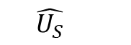

Eigen-Based MVDR
Eigen-Based MVDR
$$x\left(t\right) \\ t=1,…,T$$
Spatial Smoothing
Diagonal
Loading
$$ε$$
MVDR
$$\hat{\overline{R_{x}}}$$
$$\hat{\overline{R_{ε}}}$$
$$W_{MVDR}$$
$$W_{EB−MVDR}$$
Signal
Space Projection
$$\hat{U_{S}}$$
Sub-space
separation
$$M$$

Slide 22




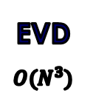


MVDR - Complexity
Eigen-Based Projection
Floating-point operations per second (FLOPS).
Measure of computer performance - computations that require floating-point calculations.
$$x\left(t\right) \\ t=1,…,T$$
Spatial Smoothing
Diagonal
Loading
$$ε$$
MVDR
$$\hat{\overline{R_{x}}}$$
$$\hat{\overline{R_{ε}}}$$
$$W_{MVDR}$$
$$W_{EB−MVDR}$$
Signal
Space Projection
$$\hat{U_{S}}$$
Subspace Projection
$$O({(M+1)N}^{2})$$
Matrix Inversion
$$O(N^{3})$$
Sub-space
separation
Weight Calculation
$$O(2N^{2}+3N)$$
$$M$$
EVD
$$O(N^{3})$$
Long computational time – burden in real-time scan

Slide 23
DNN Augmented Adaptive Beamformer

Slide 24
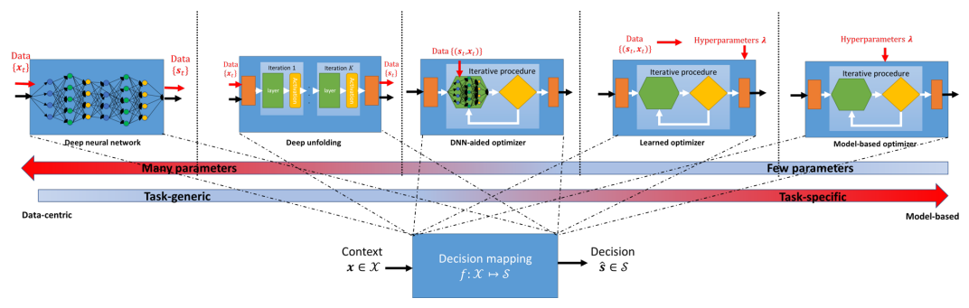
DNN Augmented Adaptive Beamformer
DNN – Aided hybrid inference (Lecture 9)
Utilize deep learning for robustifying and relaxing the dependence of model-based inference structure tailored for the problem.
Model-based algorithm specific computations are replaced with dedicated compact DNNs.
We are here
Taken from Lecture 6

Slide 25

DNN Augmented Adaptive Beamformer
Deep Augmented adaptive beamformer
Adaptive beamformer form is preserved.
Weights generation applied based on both observations and data.

Slide 26

ABLE - Adaptive Beamforming by deep Learning
Inspired by the MV beamformer, such that computationally expensive adaptive processor is replaced with Neural network.
ABLE aims not to directly improve the performances of the exist closed form solution, but to produce DNN augmented algorithm which significantly reduce the computational burden and performs just as well as the MVDR
Closed-form solution (Model – based)
Optimization Problem
DNN Augmented Inference
Requires Inversion of covariance matrix
Not requires Inversion of covariance matrix
$$w=f_{θ}\left(y\left[x, z\right]\right) \\ f_{θ}=R^{N}→R^{N}$$
weights calculated according to input observations and data
Taken from Article “Model Based Deep Learning”

Slide 27




ABLE - Adaptive Beamforming by deep Learning
Forces the network to find a compact representation of the data
Optimization Problem
Encoder
Decoder
Penalizing deviations from unity gain
Signed-mean-squared-logarithmic error (SMSLE)
Fully Connected layers
Anti-Rectifier
Latent Representation
Optimal Solution
Notes:
Encoder-decoder forces the network to find a compact representation of the data, aiding in suppression of noise and incoherent signals.

Slide 28

ABLE - Adaptive Beamforming by deep Learning

Slide 29

ABLE - Adaptive Beamforming by deep Learning
Computationally efficient
MVDR ~ 𝑂($N^{3}$), ABLE ~ 𝑂($N^{2}$)
Taken from Article “Model Based Deep Learning”

Slide 30

DNN Augmented Adaptive Beamformer
Image Loss: signed-mean-squared-logarithmic error (SMSLE) –
Weight Penalty: Inspired by MV beamforming, penalizing deviations from unity gain
Notes:
The total training loss comprised an image loss LSMSLE, and an apodization-weight penalty Lunity
The image loss is designed to promote similarity between the target image and the image produced using ABLE.
Inspired by MV beamforming, we promote a distortionless response by penalizing deviations from unity gain.

Slide 31
Results and Conclusions

Slide 32



EVALUATION
Full-Width-at- Half-Maxima (FWHM) of simulated point scatterers, which were calculated for both the lateral and the axial direction.
contrast to- noise ratio (CNR) between a low and high intensity region
Notes:
Here we can see two evaluation matrices for the reconstructed images
We can see that the ABLE is similar to the EBMV solution compere to the others beamforming methods

Slide 33

EVALUATION
Delay-and-sum (DAS) beamforming with Hanning apodization
iMAP2 beamforming
Adaptive
beamforming by deep learning (ABLE)
Eigen-Based Minimum variance (EBMV) beamforming
Notes:
From the simulated point scatters one can see that DAS beamforming yields wider and more pronounced sidelobes than iMAP2, ABLE and EBMV. The images show strong clutter suppression for ABLE and EBMV compared to DAS.

Slide 34

EVALUATION
Delay-and-sum (DAS) beamforming with Hanning apodization
iMAP2 beamforming
Adaptive
beamforming by deep learning (ABLE)
Eigen-Based Minimum variance (EBMV) beamforming
Notes:
We again observe a notable reduction in sidelobe intensity near the simulated point scatterers for ABLE and EBMV, as compared to DAS. Consequently, we see a more pronounced distinction between tissues

Slide 35


CONCLUSIONs
Compact and model-based architecture - which we term ABLE (adaptive beamforming by deep learning), enables the reconstruction of high-quality ultrasound images for multiple imaging systems.
Leverage neural networks to learn fast approximations of adaptive algorithms.
Notes:
We wanted to evaluate the ABLE beamformer, However we didn’t have an excess to the paper dataset, only to a small amount we found online. Hence, we make two simulation. The first one simulate the EBMV on it to evaluate it complexity and quality.
The second one, that Dor will talk present later, is a new scenario (not ultrasound) we tested with the ABLE.

Slide 36
Model Implementation

Slide 37






Jammer
GPS
$$r$$
$$r′$$
$$θ$$
n’th sensor
Reference
Notes:
To understand the principals behind Array processing we will analyze the simple case
We Want To Gain Some Information about Jammer That located Somewhere and Block Our GPS Communication, In order to nullify the the receiving response power
In order to to so, we will take closer look about an individual Sensor With Relation to a Reference Point.

Slide 38




Custom model
R : Distance vector between Source to reference Sensor
R’ : Distance vector between Source to $n’_{th}$ Sensor
$θ$ : Direction Between Source and Array (Far- Field)
c: Speed of Light
$$R$$
$$R′$$
$$θ$$
n’th sensor
Reference
Notes:
To understand the principals behind Array processing we will analyze the simple case

Slide 39


Custom model
Source Information lies in the difference between the Source propagation delay at reference sensor and at the $n_{th}^{′}$ sensor is:
$$R$$
$$R′$$
$$∆τ_{n}=\frac{R}{c} −\frac{R^{′}}{c}=func(R, θ)$$
$$θ$$
Reference
n’th sensor
$$∆τ_{n}=\frac{1}{c}({\left(Rsin\left(θ\right)−x_{n}\right)}^{2}+{\left(Rcos\left(θ\right)−y_{n}\right)}^{2})$$
Notes:
The difference in propagation Delay Contains Information about The Range and The Direction of the Sources

Slide 40





Custom model
Assuming Far-field Scenario and Tylor series approximation:
$$R$$
$$R$$
$$R′$$
$$R′$$
$$∆τ_{n}=\frac{1}{c}\left(x_{n}sin\left(θ\right)+y_{n}cos\left(θ\right)\right)$$
$$θ$$
$$θ$$
n’th sensor
Reference
Reference
n’th sensor
Notes:
Far Field Assumption – The sensors locations are much smaller than the Range product

Slide 41



Measurements model
The received signal at the $n^{′}th$sensor can be expressed as:
$$x_{n} (t)=α_{n}S\left(t−{∆τ}_{n}\right)+v_{n}\left(t\right)$$
Attenuation
Far-field signal
Information lies here
Sensor noise
$$v_{n}\left(t\right)\sim N^{c}\left(0,σ^{2}\right)$$
Frequency domain
$$x_{n} (w_{k})=α_{n}S\left(w_{k}\right)e^{−jω_{k}{∆τ}_{n}}+v_{n}\left(w_{k}\right)$$
Notes:
To understand the principals behind Array processing we will analyze the simple case

Slide 42



Custom model
Assuming Uniform Linear Array, propagation delay at the $n’_{th}$ sensor given by:
$$τ_{n}=\frac{\left(n−1\right)d\sin{(θ_{m})}}{c}$$
$d=\frac{λ}{2}$
Elements spacing
Uniform Linear Array spacing d
Notes:
To understand the principals behind Array processing we will analyze the simple case

Slide 43



Custom model
Assuming Narrow-Band Model, The received signal at the $n^{′}th$sensor can be expressed as:
$$x_{n}\left(t\right)=\sum_{m=1}^{M}{S_{m}\left(t\right)e^{−jω_{0}τ_{n}}}+v_{n}(t)$$
Sensor Response
Center frequency
$$w_{k}≈w_{0}=\frac{2πc}{λ}$$
Notes:
In NarrowBand Signal, Information is Centers in one dominant Bin/Frequency. This Assumption let us Work in The Baseband Area.
In practice, most of the impinging signals are wideband, where several frequency bins carry out information regarding source DOA angels.

Slide 44


Custom model
The contribution of all sensors expressed as:
$$X\left(t\right)=\sum_{m=1}^{M}{a\left(θ_{m}\right)S_{m}\left(t\right)}+V\left(t\right)$$
Array Response
steering vector at direction
$$a\left(θ_{m} \right)=\left(\begin{matrix}1 \\ e^{−\frac{i2πc}{λ}τ_{2}} \\ ⋮ \\ e^{−\frac{i2πc}{λ}τ_{N}}\end{matrix}\right)$$
Notes:
If We summarize The Contribution of All Sensors in Array We get that:

Slide 45





Matrix Form
$$X_{j}\text{ =}\text{A}\text{(}θ)S_{j}+V_{j}$$
Array Observations
Array Noise
Array response
Source Signals
$$\left(\begin{matrix}v_{1}\left(j\right) \\ ⋮ \\ v_{N}\left(j\right)\end{matrix}\right)$$
$$\left(\begin{matrix}x_{1}\left(j\right) \\ ⋮ \\ x_{N}\left(j\right)\end{matrix}\right)$$
$$\left(\begin{matrix}S_{1}\left(j\right) \\ ⋮ \\ S_{M}\left(j\right)\end{matrix}\right)$$
$$\left(a\left(θ_{1} \right)\right.|…|a(θ_M ))$$
Notes:
To understand the principals behind Array processing we will analyze the simple case

